Slide 1
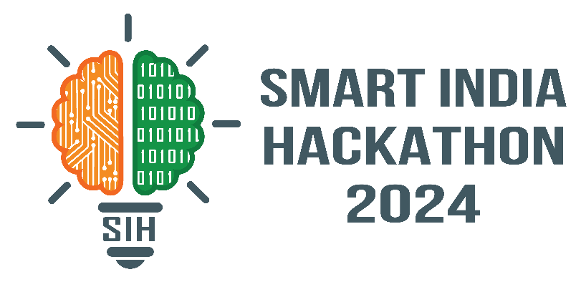

SMART INDIA HACKATHON 2024
TITLE PAGE
Problem Statement ID – SIH1528
Problem Statement Title-Student Innovation
Theme- Miscellaneous
PS Category- Hardware
Team ID-
Team Name (Registered on portal) - CodeCrafters

Slide 2
IDEA TITLE
CodeCrafters
ULTRASONIC GLASSES FOR BLIND:
Obstacle Detection: Ultrasonic sensors scan the environment from various angles to detect obstacles and provide real-time feedback to the user.
Customizable Vibration Alerts: The device uses vibration patterns to intuitively alert the user about nearby obstacles and changes in their surroundings.
Crowd Navigation: It assists users in navigating through crowded spaces safely, helping to avoid collisions and manage dense environments effectively.
Fall Detection and Emergency Alerts: The device can detect falls and automatically send an SOS message or call an emergency contact with the user's location, ensuring quick assistance in emergencies.
The vibration feedback system is customizable.
The addition of crowd navigation, a feature not commonly found in existing devices, enables users to move confidently through busy spaces.
This holistic approach makes the device a unique and innovative solution for enhancing mobility and safety for the visually impaired.

Slide 3
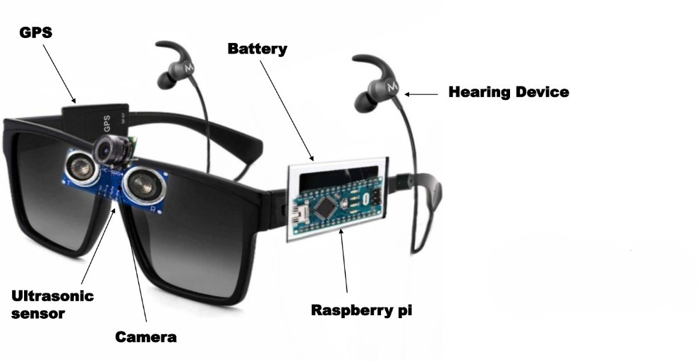
TECHNICAL APPROACH
CodeCrafters
Programming Languages – Python, C, Java
Frameworks - Django
Hardware – GPS sensor, battery, raspberry pi/Arduino, ultrasonic sensor, hearing device, camera, vibration motor/buzzer, IMU, Frame, Breadboard, Jumper wires

Slide 4
FEASIBILITY AND VIABILITY
CodeCrafters
CodeCrafters
FEASIBILITY:
Component Availability: Affordable and accessible.
Technical Integration:
Ultrasonic Sensors for obstacle detection.
Vibration Motors for silent feedback.
Atmega 328 for efficient processing.
Power Management: Requires lightweight, long-lasting battery.
Comfort: Lightweight design critical for wearability.
VIABLITY:
Durability: Designed to be water-resistant, impact-proof, and low-maintenance.
Market Potential: Addresses the growing demand for wearable assistive technology.
Cost: Engineered to be affordable for wide accessibility.
Safety: Ensures reliability with built-in fail-safes for user protection.
User Acceptance: Intuitive, non-intrusive, and easy to use

Slide 5
IMPACT AND BENEFITS
CodeCrafters
1. Impact on the Target Audience:
Enhanced Mobility and Independence: Users can navigate environments more confidently and safely, reducing accidents and falls.
Boosted Confidence and Quality of Life: Increased autonomy improves participation in daily activities and social interactions.
Access to New Opportunities: Better navigation capabilities enable users to pursue work, education, and social activities previously challenging or inaccessible.
2. Benefits of the Solution:
Social Benefits:
Increased Inclusivity: Enhances access to public spaces for visually impaired individuals, fostering more equitable communities.
Reduced Isolation: Boosts mobility and social interaction, decreasing feelings of isolation.
Economic Benefits:
Expanded Job Opportunities: Facilitates navigation, leading to broader employment options and better financial stability.
Cost Savings: Lowers medical expenses and reduces overall costs for individuals and healthcare systems.
Environmental Benefits:
Sustainable Design: Utilizes eco-friendly materials and energy-efficient technology, reducing environmental impact.
Efficient Public Space Use: Minimizes the need for additional infrastructure, supporting sustainable urban planning.

Slide 6
RESEARCH AND REFERENCES
CodeCrafters
Ultrasonic Sensor Technology - https://ieeexplore.ieee.org/
Vibration Feedback in Assistive Devices- https://www.annualreviews.org/
Crowd Navigation Algorithms - https://www.sciencedirect.com/
Assistive Technology for the Visually Impaired- https://link.springer.com/

